Slide 1









Slide 2


Agenda
Sendinblue Overview
Value Propositions
Platform Tour
How we help you stand out?
Enterprise Plan
Our Happy Customers!!

Slide 3


Make your business take flight with the complete sales & marketing toolbox.
Grow. Sell. Engage.

Slide 4










The All-in-one Marketing Platform
Email & SMS Campaigns
Drag & Drop
Editor
A/B Testing
Facebook Ads
Retargeting
Marketing
Automation
Send time
Optimization
Chat
CRM
Landing Pages

Slide 5



Overview
WE GROW WITH YOU
WORLDWIDE TEAM
Senior Engineering and Customer Success team
Offices in Paris, Seattle, Berlin and New Delhi
2012
2014
2016
2017
2019
Launched Sendinblue with Email campaigns
Marketing Automation
Seattle Office
30M€ Funding
Multi-Channel Platform

Slide 6






Noteworthy Stats
80k+
160
100M
Clients
Countries served
Emails/SMS per day
99%
30M
6
Deliverability rate
Partech Ventures
Languages
4
250+
Offices worldwide
Employees

Slide 7













Clients
Sendinblue has more than 80 000 clients from more than 160 countries.
Small and big companies trust Sendinblue.

Slide 8





Value Propositions
Communicate
Personalize
Convert
Improve
Automate
Integrate

Slide 9
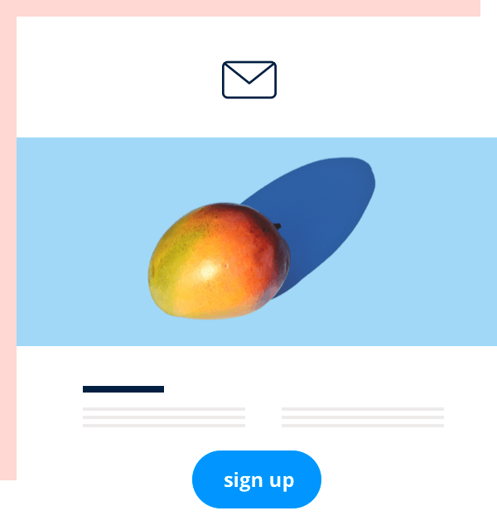
COMMUNICATE
Email Marketing
Get the word out and sell more with sleek email messages that you can design in no time
SMS Marketing
Communicate more directly with customers for urgent messages or time-sensitive offers
Chat
Be there for customers instantly when they have a question while browsing your site

Slide 10
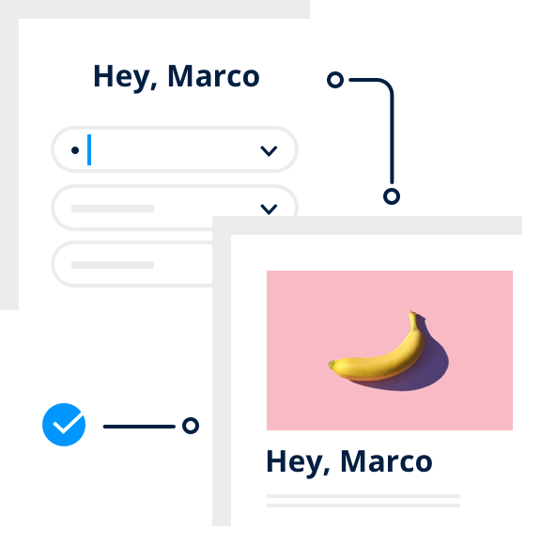
PERSONALIZE
Marketing Automation
Save time and boost performance by automating your segmentation and marketing messages.
Segmentation
Get more engagement by sending your marketing messages to a more targeted audience.
Transaction Email
Step up the design, engagement, and deliverability of your transactional email messages.

Slide 11
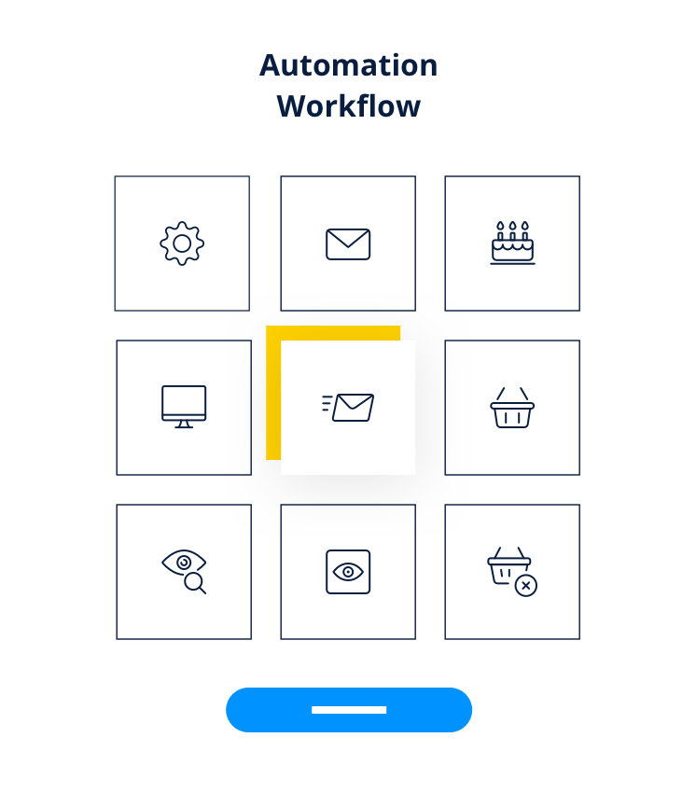
PERSONALIZE
Workflows
Build your own
Pick from the library

Slide 12
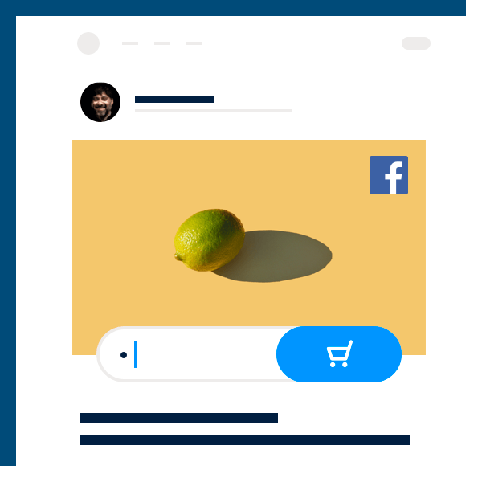




CONVERT
CRM
Build stronger relationships by keeping track of all your customer details in one place.
Landing Pages
Create a more targeted visitor experience with dedicated pages for each of your campaigns.
Signup Forms
Grow your email contact list with custom forms that you can integrate in your website.
Facebook Ads
Launch Facebook ads from your account to retarget contacts or reach new audiences based on your contact lists.

Slide 13



IMPROVE
Open & Click-through Reports
A/B Testing
Follow your email performance and learn what works with detailed statistics for each campaign.
Boost performance by testing two ideas in your email and letting data choose the best one.
Email Heat Map
Send Time Optimization
Real-time Statistics
Visualize how contacts read and engage with your emails to improve future campaign designs.
Send at the perfect time with just one click using our machine learning-powered send time algorithm.
Stay on top of performance as it happens and know about any issues as they happen.

Slide 14
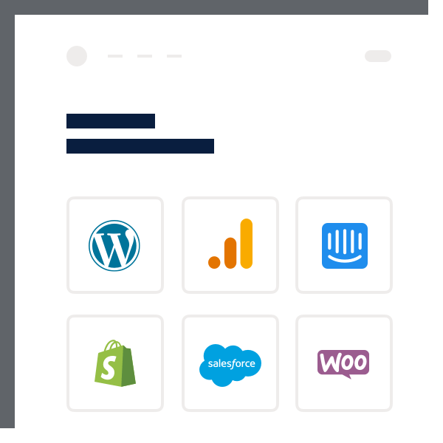
INTEGRATE
API
Integrate Sendinblue features into any tool or product, regardless of your technical setup.
Plugins
Get more from the tools you use by connecting them with Sendinblue.

Slide 15

Platform Tour
Ready to find your marketing zen?
Take the stress out of your work day with a solution that’s built for you!

Slide 16
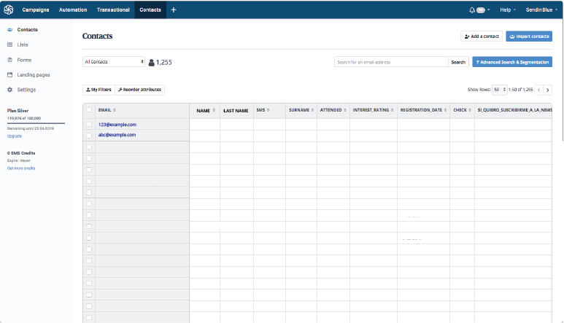
FEATURE l : CONTACT MANAGEMENT
Contacts Management
ç
Organize your contacts
Create folders and lists
Create attributes and formulas
Segment them effectively
Filter contacts based on contact information and behavior
Save filters for dynamic segmentation
Subscription forms
Create forms easily to add in your website
Use plugins to automatically import contacts from your websites

Slide 17
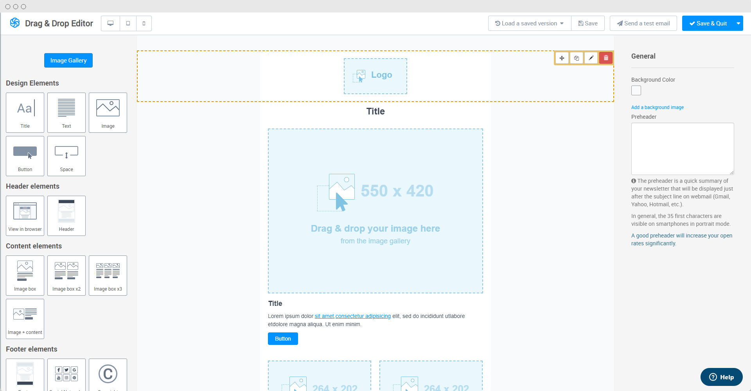
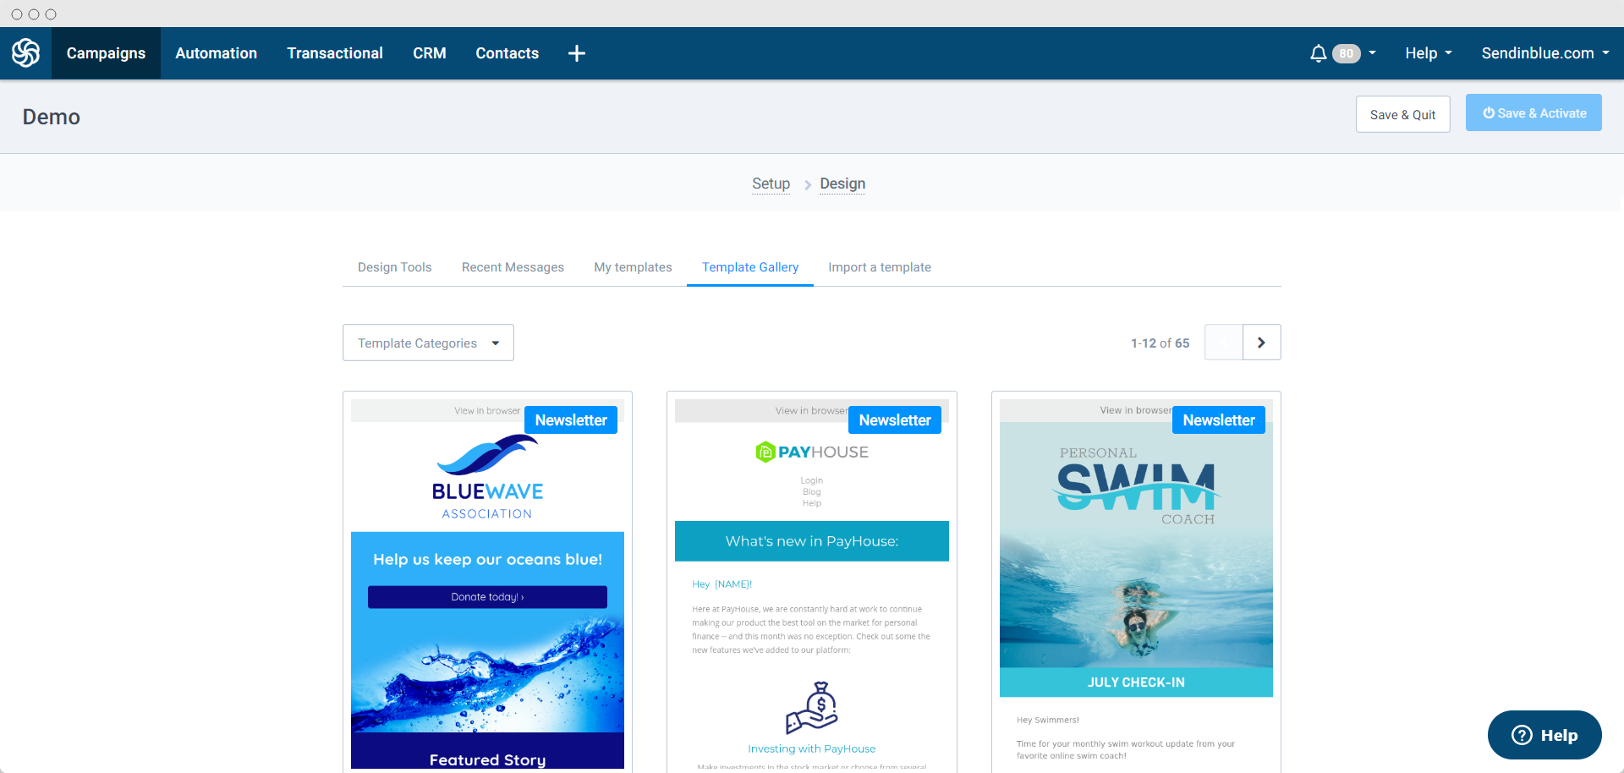
FEATURE Il : TEMPLATE CREATION
Template Creator
Powerful template features
Advanced content personnalisation
Send test emails or preview before sending
Manage campaign and transactional templates
Drag & Drop Editor
Email builder without HTML
Drag and drop different elements
Pre-made templates for quick use
Responsive templates: Mobile friendly

Slide 18
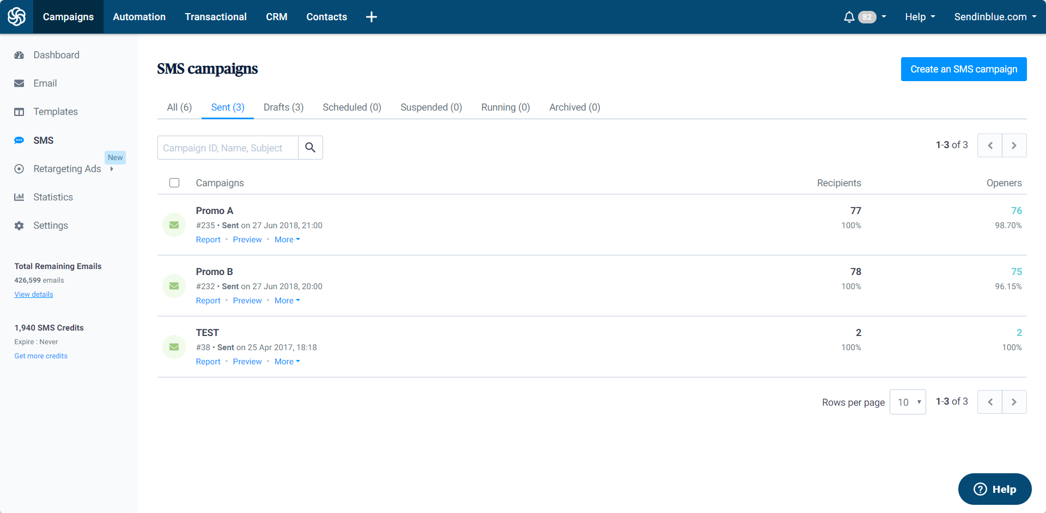


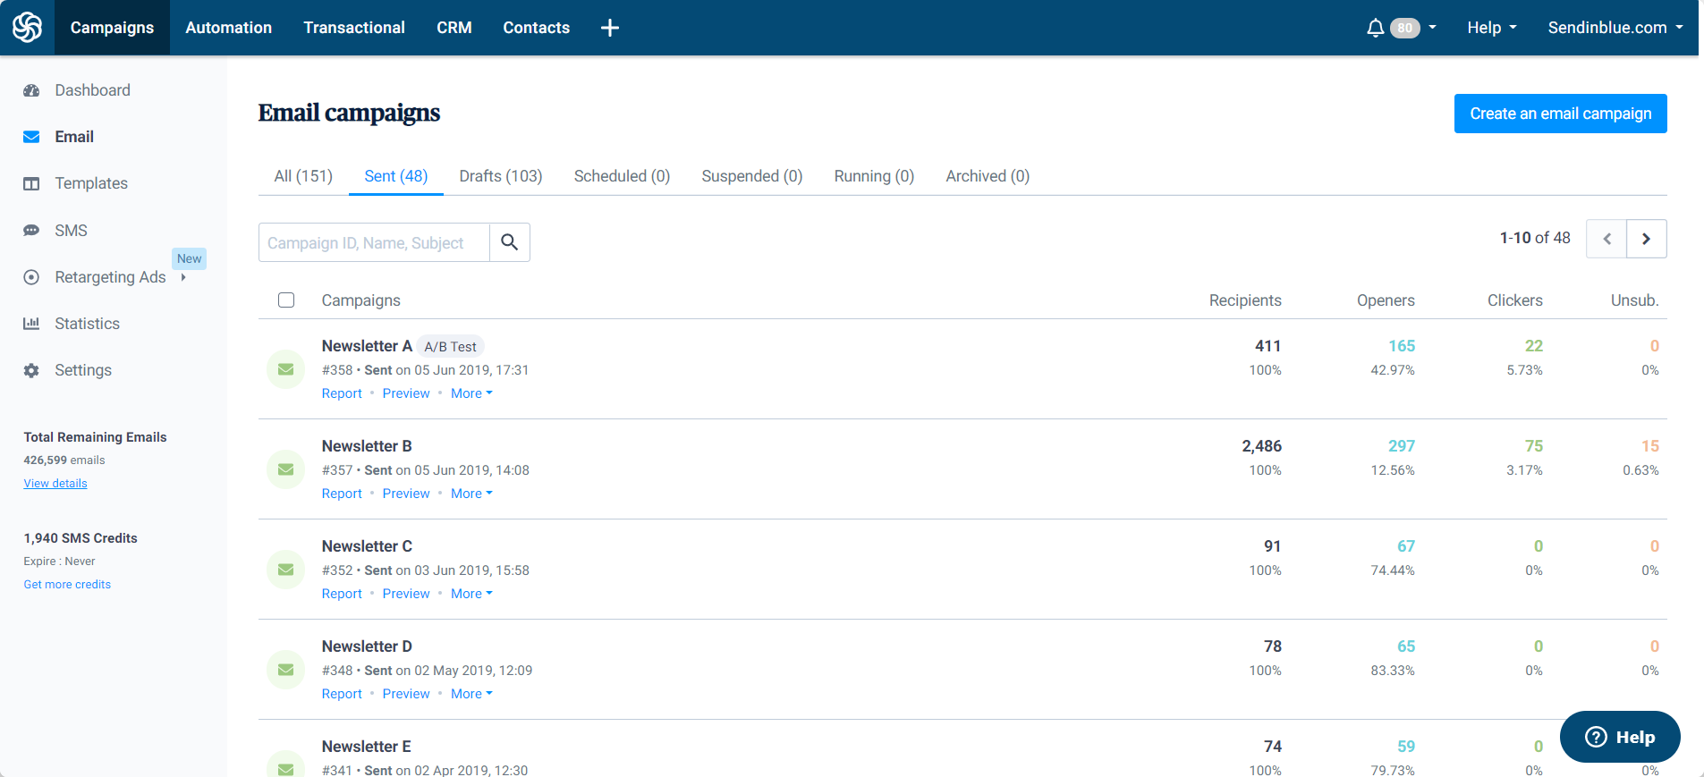
FEATURE III: MULTI-CHANNEL MARKETING CAMPAIGNS
Multi-channel Marketing Campaigns
Email Campaigns
SMS Campaigns
Email or SMS campaigns
Program a campaign in a few minutes
Import HTML email template or use Drag & Drop editor
Campaigns classification by tags
UTM personalization for Analytics tracking

Slide 19
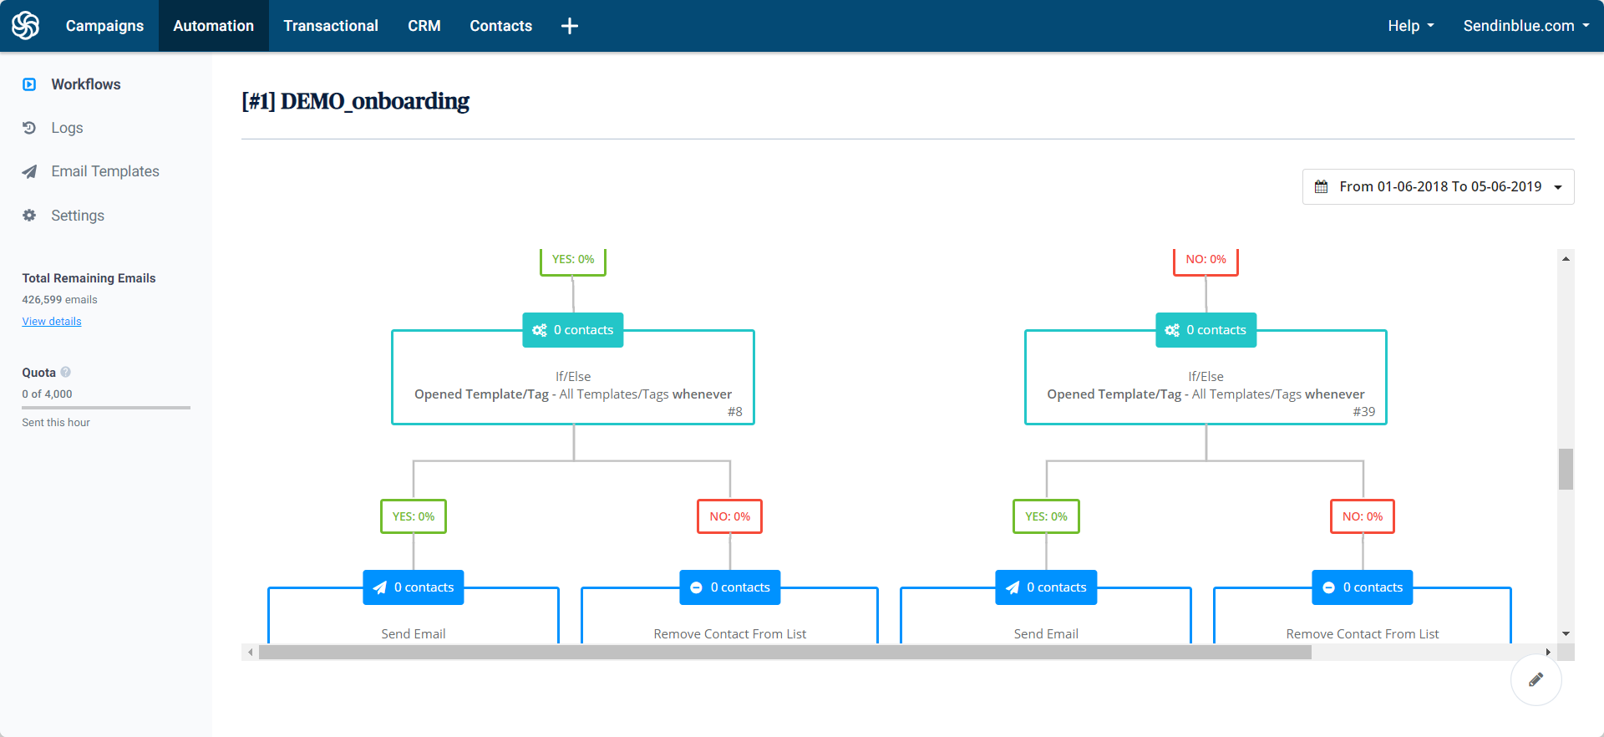
FEATURE IV: MARKETING AUTOMATION
Marketing Automation
Powerful website tracking
Easily track all pageviews / events for identified users
Use pageviews and events as workflows triggers or conditions, and template variables.
Workflow builder & Segmentation
Build advanced workflows easily
Pre-made or custom workflows
Large number of actions offered: Send email, SMS or both, allocate scoring for each contact for accurate segmentation

Slide 20
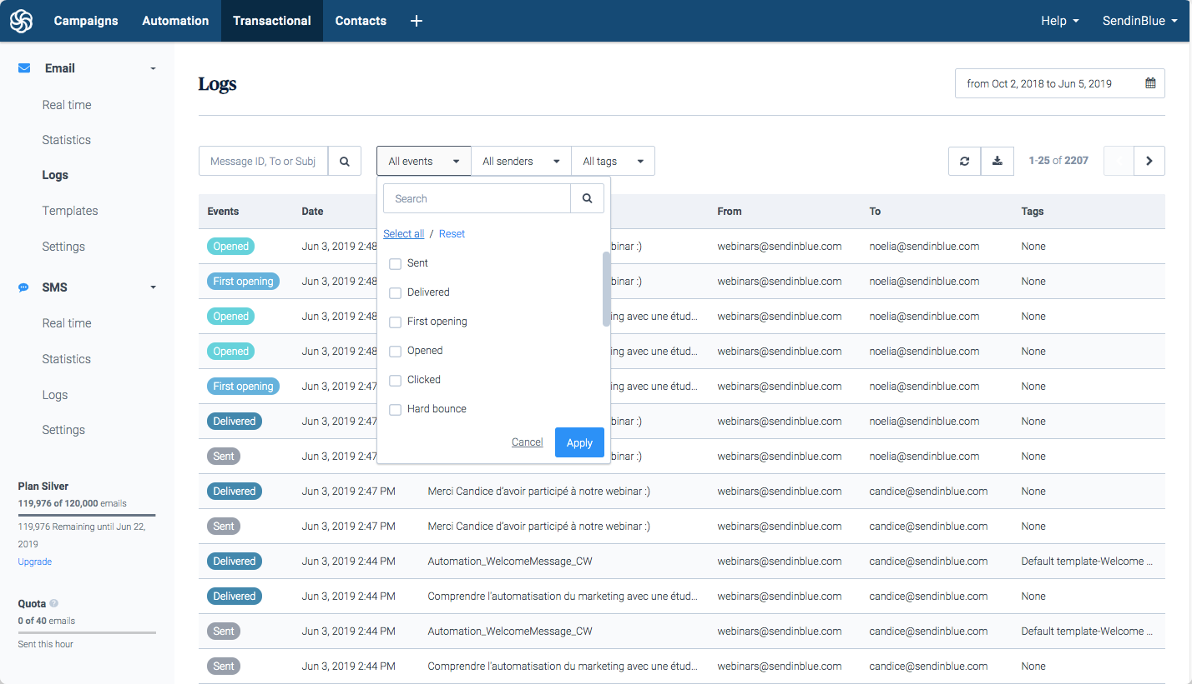
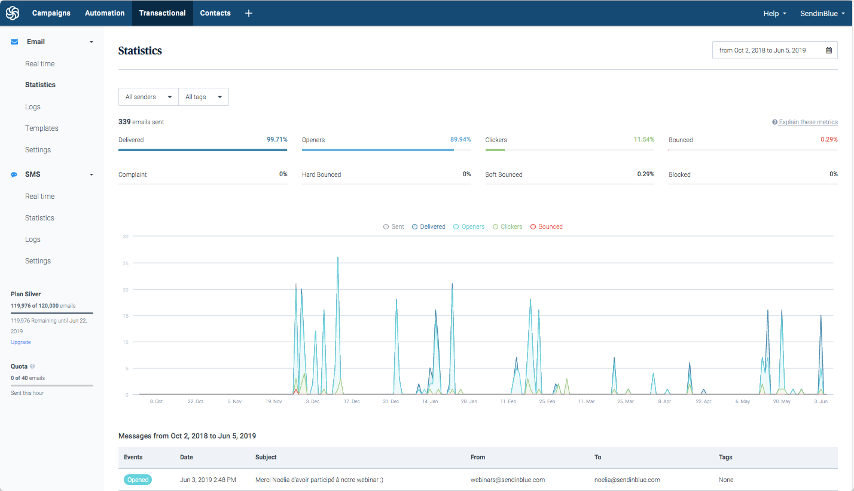
FEATURE V: TRANSACTIONAL EMAILS
Transactional Emails
Real time data every second
SMTP & HTTP API
Complete logs and data
Exports to CSV or via Webhooks

Slide 21

FEATURE V: TRANSACTIONAL EMAILS
Transactional Emails
Dynamic Templating Language
Transactional Reporting
Dynamically update templates at time of sending with specific content
Use complex logic setups with full conditionals such as if, then, else, else if, and more, or loop over JSON arrays using each.
Pull complete data-sets via Webhooks
View real time statistics and logs via the UI (per second updates)
Report breakdowns on data such as; Template tags, Sender ID’s, Time/Date, Event types (Bounced, delivered, opened etc.)

Slide 22
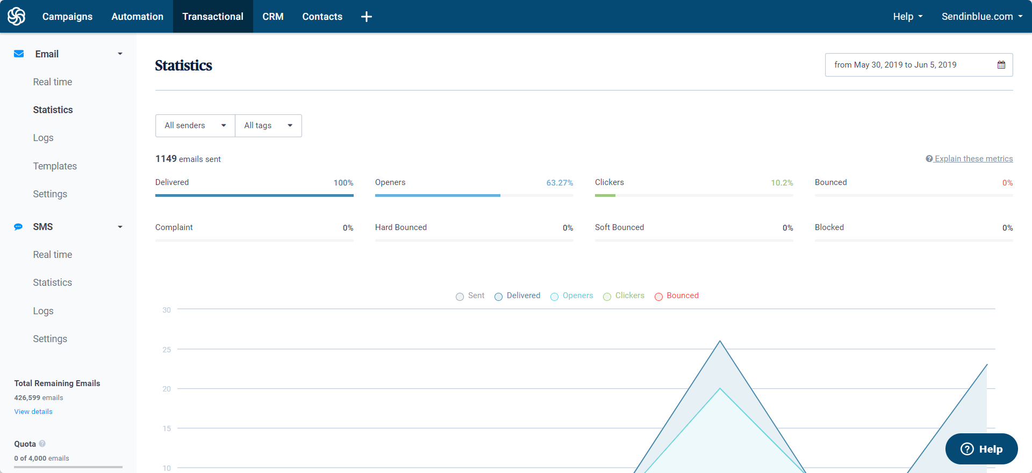
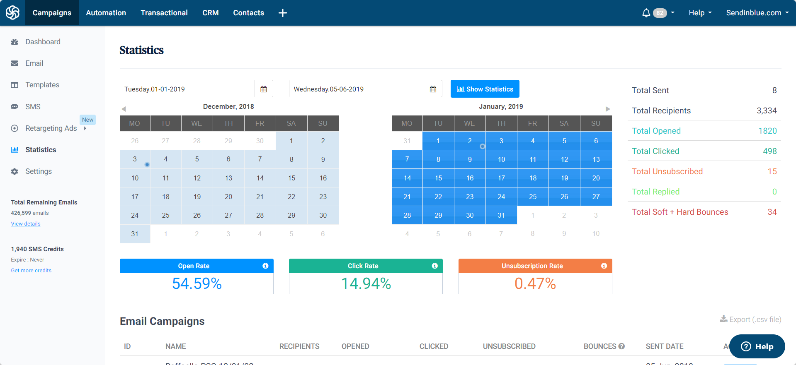
FEATURE VI: POWERFUL REPORTS
Powerful Reports
Email campaigns reports
Advanced statistics: mobile / webmail, ISP centric, heatmap, etc.
PDF / CSV report exports
Transactional / Automation reports
Get statistics per template, tag or workflow
Detailed workflow statistics

Slide 23

We help you stand out
Send Time Optimization
A/B Testing
Deliverability Expertise
Easy setup
Security & Data protection

Slide 24
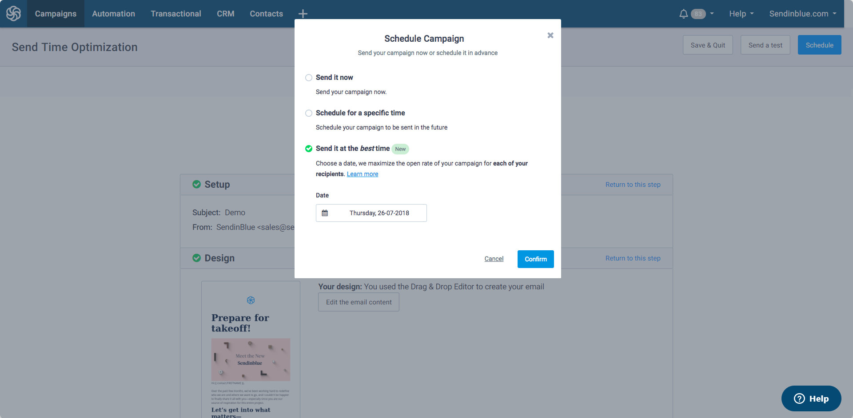

ADVANCE PERSOANLIZATION
Send Time Optimization

Slide 25

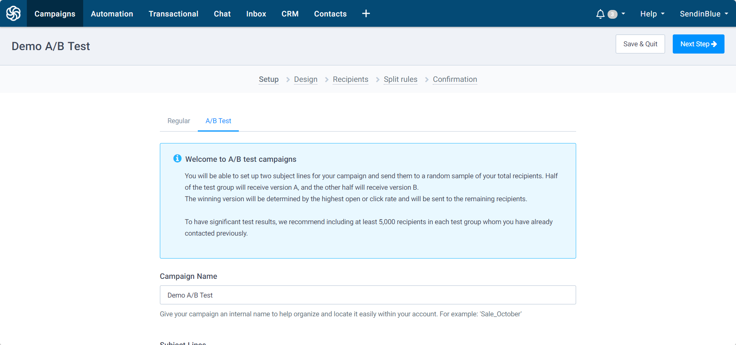
ADVANCE PERSOANLIZATION
A/B Testing
VS

Slide 26



99% DELIVERABILITY RATE
Deliverability Expertise
Full deliverability monitoring
Easily set up SPF, DKIM and DMARC to authenticate your domain
IP / domain reputation dashboard
IP pool management between accounts (advanced)
Strong deliverability expertise
Internal MTA managed by dedicated deliverability team
Good relationships with most email infrastructure providers

Slide 27

STRONG ECOSYSTEM
Easy to Setup
Powerful Restful API
Almost all features are available with API
Full API documentation available
Website & CRM plugins
Plugins helps you to configure transactional email, web tracking or optin forms.
Plugins for WordPress, Salesforce, Magento, Drupal, etc.
Zapier / Integratomat integrations

Slide 28

Security and data protection
GDPR compliance & data protection
External GDPR audit on regular basis
Top level data protection internal processes
Best security practices
Regular Security audits & Bounty programs
Advanced data redundancy
Security dedicated team

Slide 29
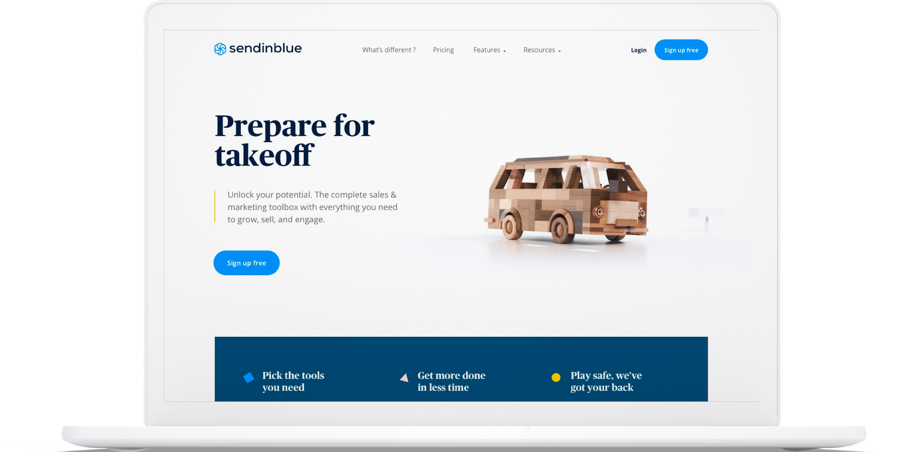
Sendinblue provides a powerful enterprise tool with first class support and advising for its enterprise clients to have complete confidence in their email sending.
Enterprise Plan

Slide 30
Platform + Emails + Service
Entreprise plans include both features, emails / SMS and services.
Platform
Customer Success Manager
Support
ACCESS TO ALL FEATURES
SUPPORT
PRIORITY
Level 1: Customer Care agents
Priority ticket & phone support
Available 24/7
Level: 2 Customer success manager
Direct email / phone line support
Quarterly business review meeting with account manager
Deliverability / Performance analysis and recommendations
Email / SMS campaigns
Marketing Automation
Transactional / SMTP
Unlimited contacts
Website tracking
Multi user
SLA 99.9% uptime
Kick Off meeting to define roadmap
Product Training
Setup Assistance
IP Pool Warm up
Expert advice on best practices
Customised onboarding program

Slide 31
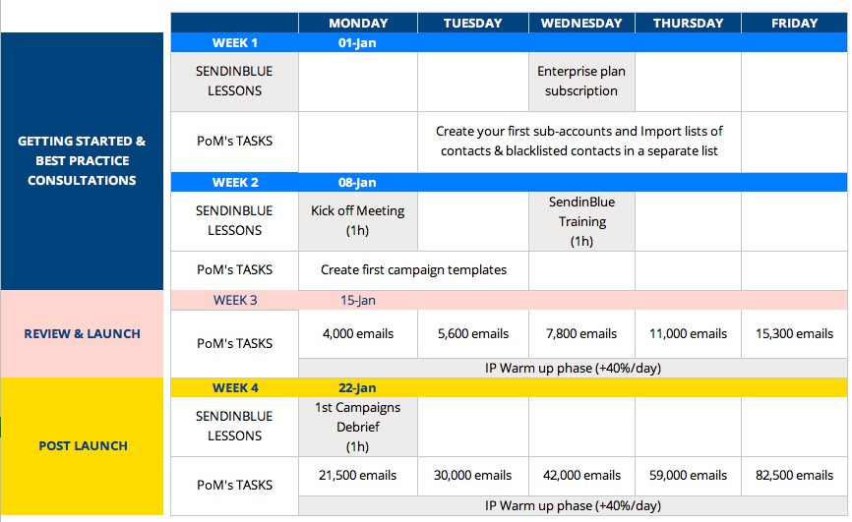
On-boarding
Customised Program
We work with you to define the right warmup process for your specific situation and requirements

Slide 32
The Commercials
Indicative Self-Service Pricing
Enterprise Proposition for Ola

Slide 33
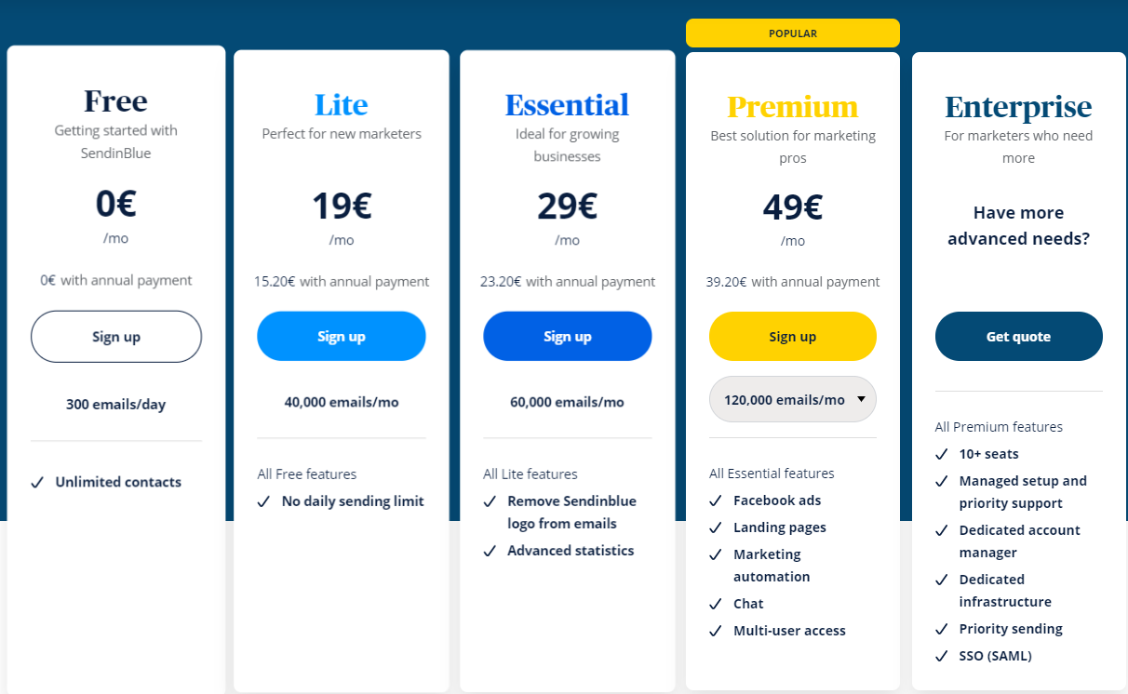
Self-Service Pricing

Slide 34
Enterprise Proposition For Ola
Volumes (emails / year) | CPM (Cost per thousand in €)
< 25 million | 0.20
25 – 50 million | 0.18
50 - 70 million | 0.15
70-80 million | 0.12
80 million – 1 billion | 0.10

Slide 35
Thank
You

